Slide 1
Python Programming
Prof. Sujit M. Deokar,
Department of Engineering & Sciences Humanities
Vishwakarma Institute of Technology, Pune

Slide 2
Variables & Datatypes
Choosing Good Identifiers
An identifier is just a name label.
Luckily Python does not allow you to name variables after any essential parts of the language.

Slide 3
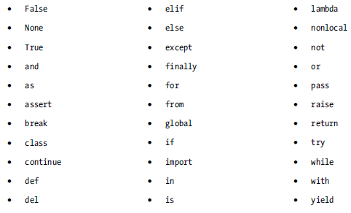
Python Keywords

Slide 4
Following the Naming Rules
Variable names must begin with either a letter or an underscore.
Python is generally case-sensitive.
It is also a good idea to keep your own record of names you have already used.

Slide 5
Recognizing different Type of Varibles
number = 0
roll_width = 1.4
price_per_metre = 5
filename = 'data.txt'
trace = False
sentence = "this is a whole lot of nothing"
total_price = roll_width * price_per_metre
Python recognizes several different types of variables: string literals (words), numbers, sequences (lists), mappings (dictionaries), and Booleans (true or false values).

Slide 6
Working with Dynamic typing
In Python, once a value has been assigned to a variable, the interpreter will then decide what sort of value it is (i.e., a number, some text, or some other relevant quality). This is known as dynamic typing.
Dynamic typing makes it much easier to handle different types of unpredictable user input.
Beware: Python won’t complain unless you try to use a variable before you have actually assigned it a value.
Python needs to keep track of the type of a variable for two main reasons.
Chiefly, the machine needs to set aside enough memory to store the data.
For keeping track of types helps to avoid and troubleshoot errors.

